Slide 1

Cyber Rush Hour
Game for Android
Developed for “Consumer-side development on Android” Course
Developed by Michael Voronov

Slide 2
Application Description:
A “Rush Hour”* type game, using an abstract art style for its theme
Core Audience – kids ages 5 and above
Includes a connection to a database to keep high scores for comparison.
Fully localized for English and Hebrew audiences.
*Rush Hour is a game about moving a vehicle through a traffic jam puzzle to reach its end goal.

Slide 3
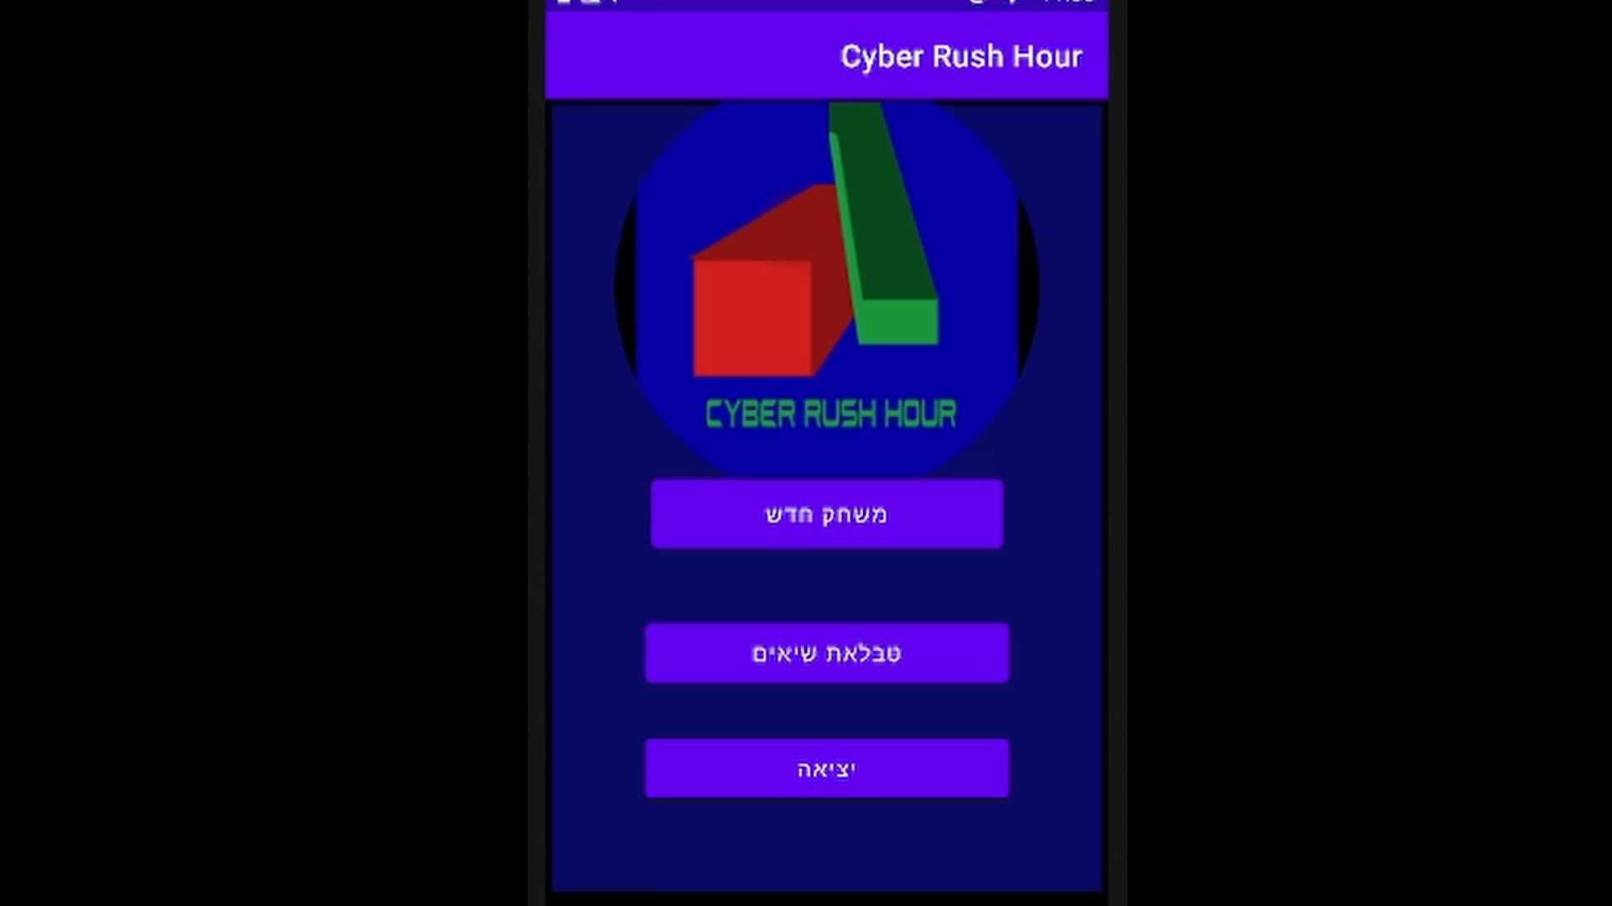
Video Demonstration (In Hebrew)

Slide 4
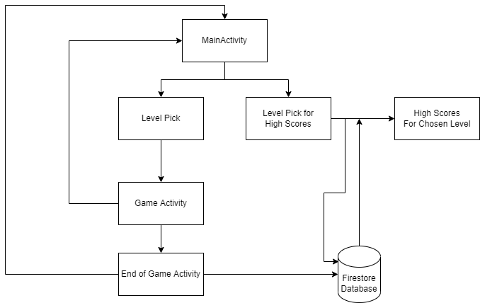
Application Activities Flowchart: *Every cell will be elaborated upon in further slides

Slide 5
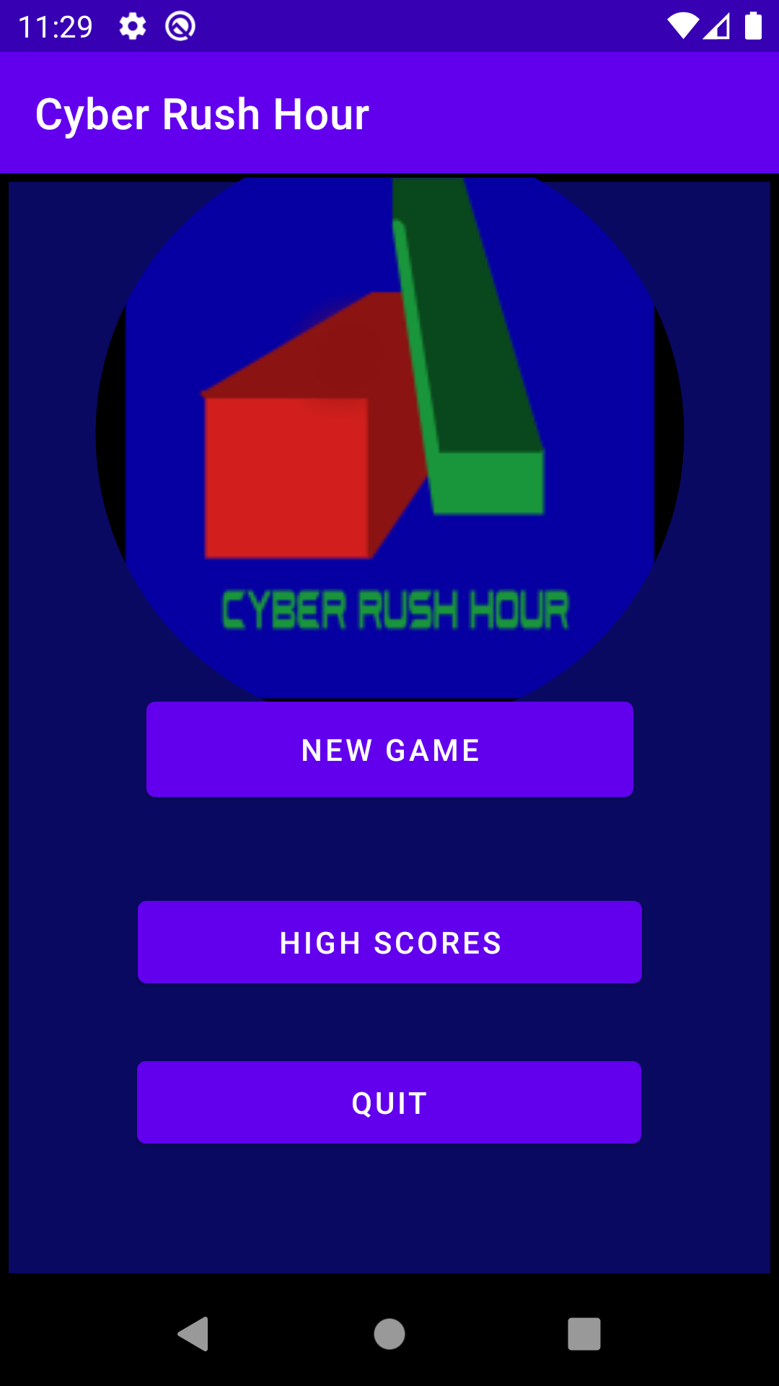
The Main Activity:
The main menu, first screen you see upon launch.
Includes the game logo and three buttons.
“New game” takes us to the Level pick activity
“High Scores” takes us to high scores level pick activity
“Quit” closes the application

Slide 6
Code:
Includes a basic onCreate and three methods, one for each button.
Each button (outside of Exit) creates an intent and leads to the corresponding activity.
Example – switching to game scene:
public void switchToGameScene(View view){ Intent intent = new Intent(this, LevelPickActivity.class); startActivity(intent); }

Slide 7
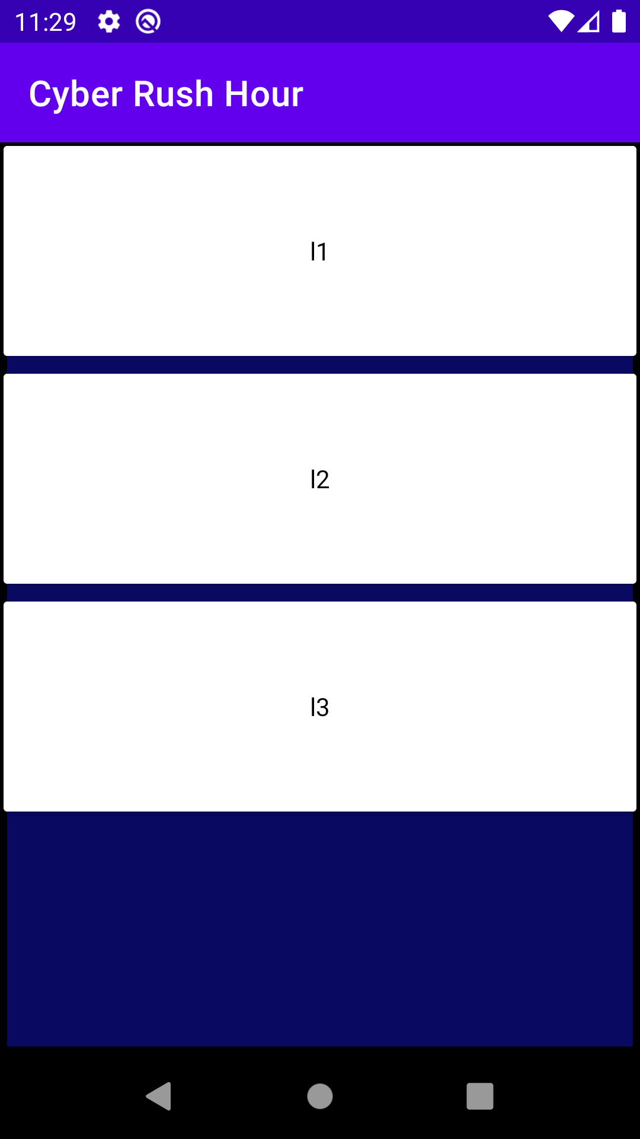
High Scores Level Pick Activity:
Connects to the Firebase Database
Downloads all available level names
Creates a clickable instance of each level name
Upon clicking on a chosen level, switches to the High Scores activity

Slide 8
Code:
Uses the Firebase Firestore library to listen and get snapshots
Uses ArrayList
Uses a custom made Adapter for the inflation of the list.
Has a reference to the listview that is in this layout, and upon creation it gets a snapshot of the collection from the database, and sends the list of level names into the adapter. The LVAdapterForNames is the one responsible to inflate the listview with a layout that is levelname_listview_item.
The custom adapter also includes an OnClick that starts a new activity with the intent that includes the name of the level clicked on.

Slide 9
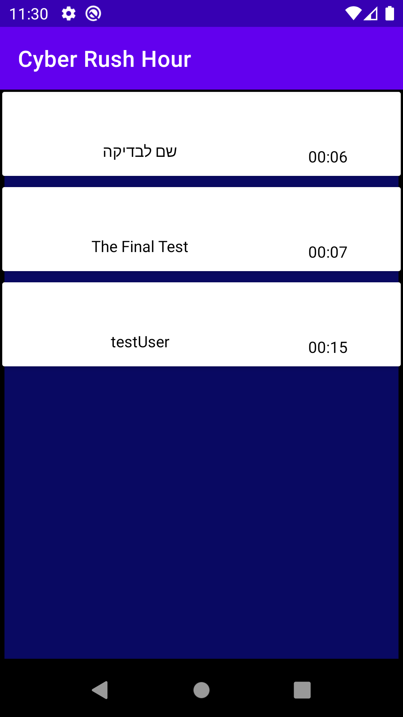
High Scores Activity:
Connects to the Firebase Database
Uses the chosen level Name from the previous screen to download the correct High Scores for that level
High scores are sorted by shortest amount of time first

Slide 10
Code
Works practically the same as the previous Activity.
Main difference it has its own custom adapter LVAdapterForScores, because it needs to inflate the current listview with a different type of item both layoutwise and objectwise.
Also does not include an OnClick function.

Slide 11
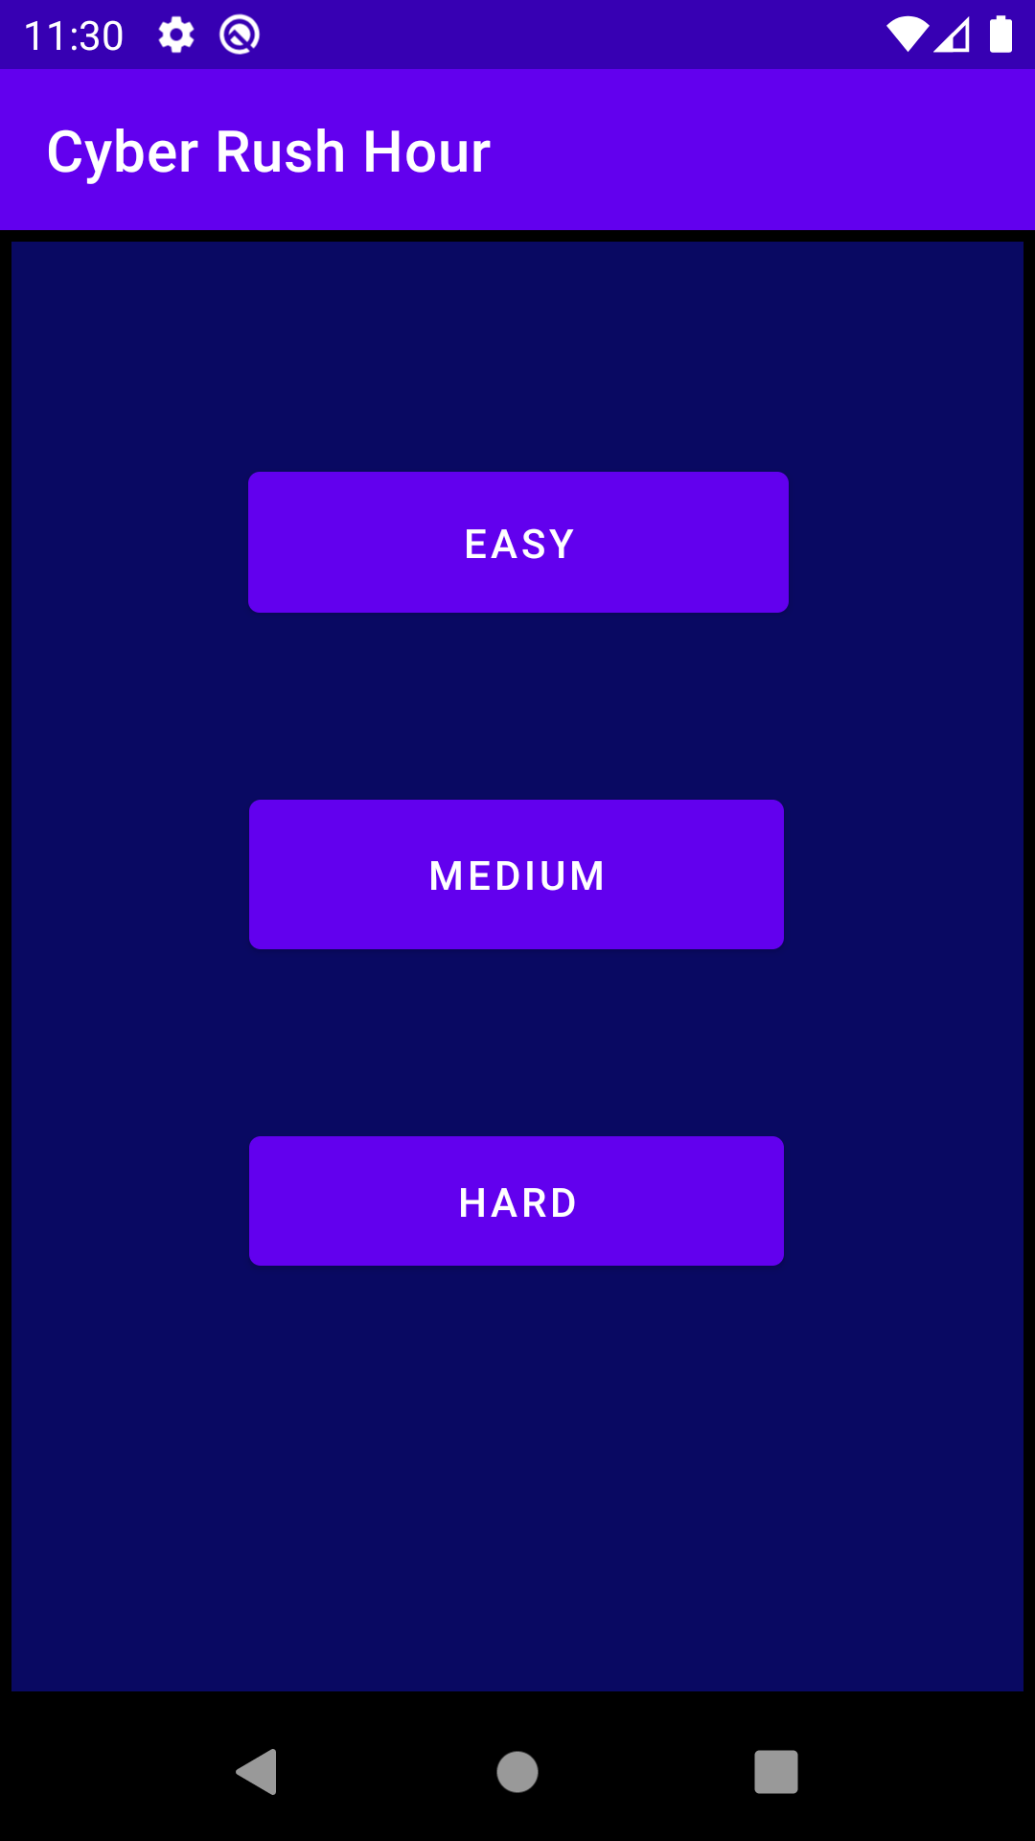
Level Pick Activity:
Includes three difficulties, each corresponding its own button.
Upon click, moves to the Game screen with the chosen difficulty.
*At the time of base release, only three levels are available, one for each difficulty

Slide 12
Code:
Works practically the same as the Main Activity code.
Difference is each button creates an intent and adds the difficulty level to be read in the next activity that it activates
Terminates itself upon click before starting the next activity
Example:
public void pickEasy(View v){ Intent intent = new Intent(this, GameActivity.class); intent.putExtra("Difficulty", 1); finish(); startActivity(intent); }

Slide 13
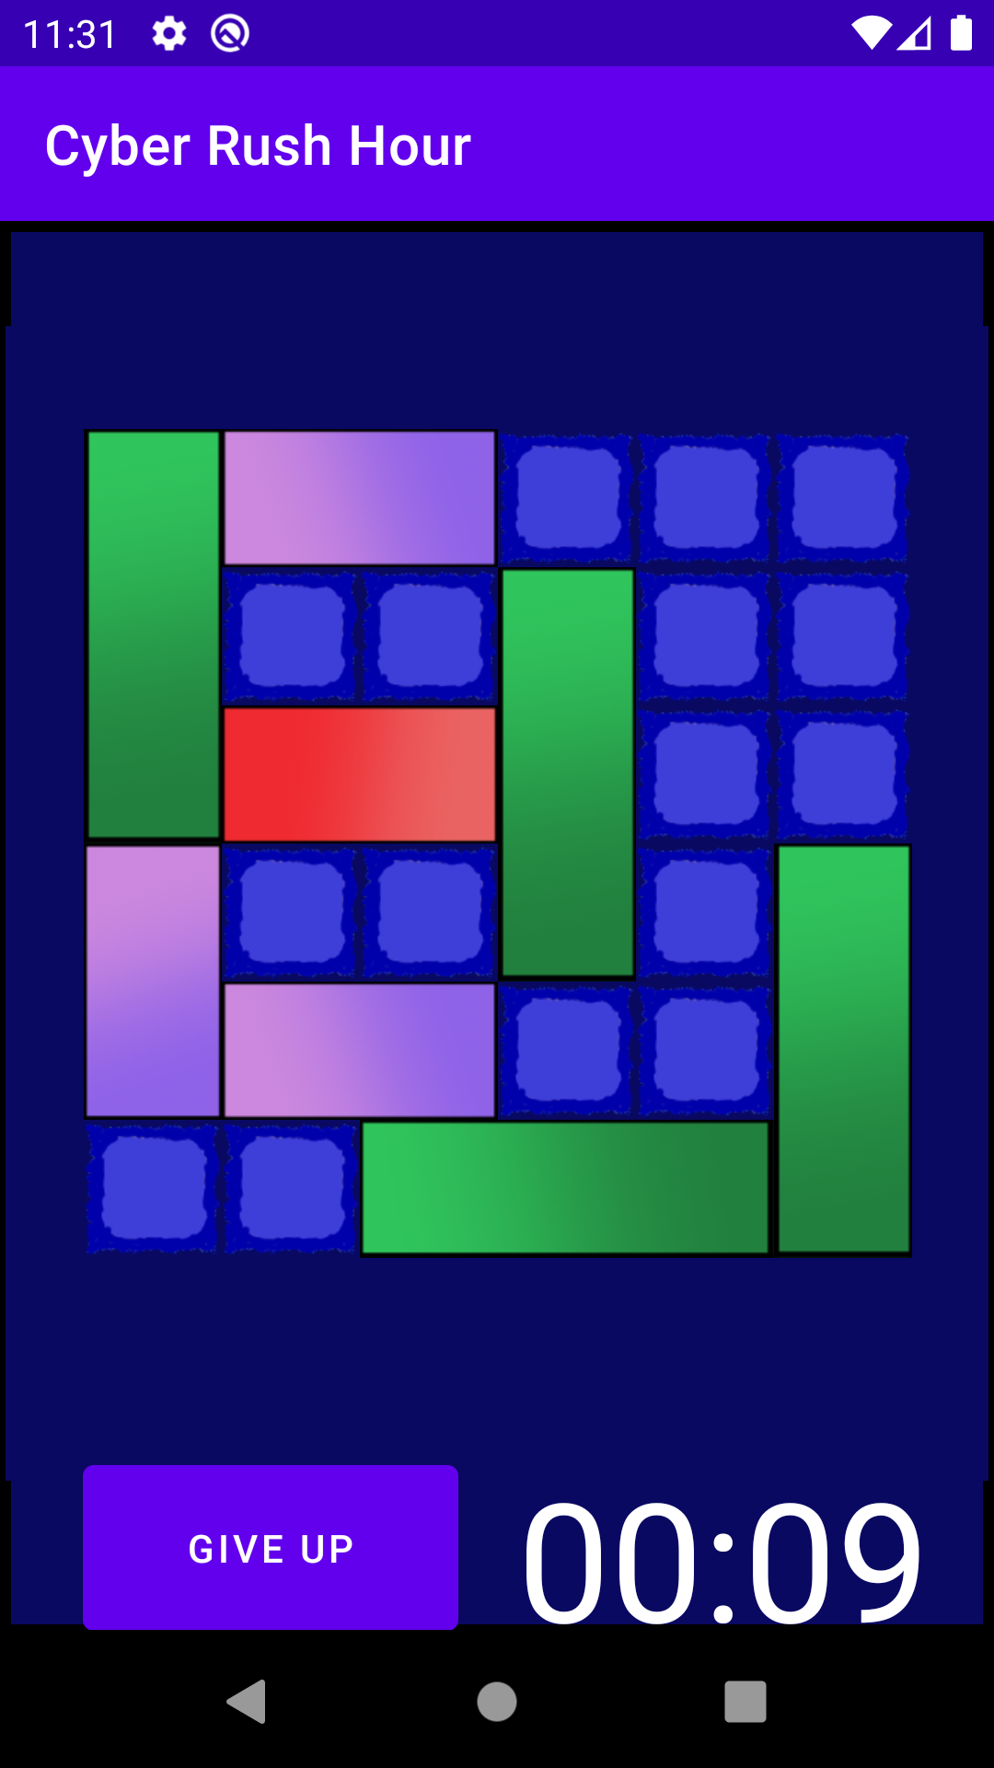
Game Screen Activity:
Includes a SurfaceView type class
Has a game screen with the chosen level loaded in
Each “car” is clickable.
Depending on the side of the click, the movement will be corresponding. (left-right/up-down)
Has a timer at the bottom that will update until you end the level by reaching the right most section with the red car.
Includes a Give Up button that takes you back to the main menu
*For demonstration the easy level was picked

Slide 14
Code:
Game Activity is the main holder of the activity. It holds a reference to the Game Screen class elaborated upon in the next slide and a timer object from Java Utilities library.
On create we send the difficulty that we received via Intent into the Game Screen class and initiate it.
Right afterwards we initiate a timer runnable and update our TextView of the timer in the layout
Includes a giveUp function that simply closes the current activity, what sends us back into the main menu.

Slide 15
Game Screen Class:
Custom class, extends SurfaceView.
Holds in it a reference to a Game World class (elaborated in the next slide) and a Game Thread to run it on a separate thread and smooth the animation.
Uses the Android Graphics Canvas
Has a setDifficulty function that uses the received difficulty from the Game Activity and sets it for further use.
Upon surface Creation we update it that it can redraw itself upon change and set the resolution of the game world by sending it the full screen size.
Then we start the thread.
The draw function sends the canvas over into the gameworld to be rendered and drawn on.
On Initialization via Init() we create the GameWorld by sending it context and the selected difficulty, we set the Touch listener onto the gameworld, add a callback and create the thread for the gamescreen.

Slide 16
Game World Class:
Creates the Board object, sets the difficulty, handles all the bitmaps, places the cars according to the difficulty, handles the movement matrix, handles the onTouch, checks the win condition.
On creation it receives a list of cars via the LevelPicker method that receives a LevelsFactory instance.
LevelPicker – asks the LevelsFactory for the list of cars for a specific level and returns it.
renderWorld – draws the background, then the board created at the start, then each vehicle in the list.
setResolution – sets the resolution for the world according to the phone sizes, then handles the resolution of the cars via HandleCars().
HandleCars() - Sets the size for a block width for the cars to use, places them according to their appropriate X,Y position, sets the correct image and finds the main car. At the end, updates the placement matrix.
setTile – returns the image corresponding to the car type
onTouch – Depending on the action, it will either find the car that’s pressed on and handle its movement, or remove the temporary found car from its reference, check for win condition and then invalidate the scene to cause a reDraw.
checkWinCondition() – checks via the matrix if the two blocks that have to be taken for a win are taken by the red car. If so it ends the activity, records the time and level name into the intent and sends it all into the End Of Game activity.

Slide 17
Car Class:
Has a starting X,Y position, its width, height and type. Also has a blockWidth and a gridX and gridY integers in it.
Draw() – receives a canvas and draws a rectangle according to the right size, using the image of the correct car type.
isInArea() – used during the onTouch of the Game World class, it receives coordinates and compares them to the edges of the car, returning true if we hit it.
handleMovement() – recieves the placement matrix and coordinates of the press. Depending on the type of car, it will handle its movement accordingly.
handleHorizontal() – splits into two functions, MoveLeft or MoveRight, depending if we pressed to the left or right side of the center of the car.
handleVertical() - does the same just with MoveUp or MoveDown.

Slide 18
Miscellaneous classes:
Board – has a reference to the square tile that is drawn on the background, gets the canvas, checks the size required and draws the correct amount of blocks
Common – custom class to handle calling bitmaps from Assets via asset manager. Quality of Life class.
LevelsFactory – receives a call and returns a list of cars corresponding to a level. At the moment, all three levels are hard coded, manually created cars.
HighScoreObject – holds a HashMap of two string values, time and name

Slide 19
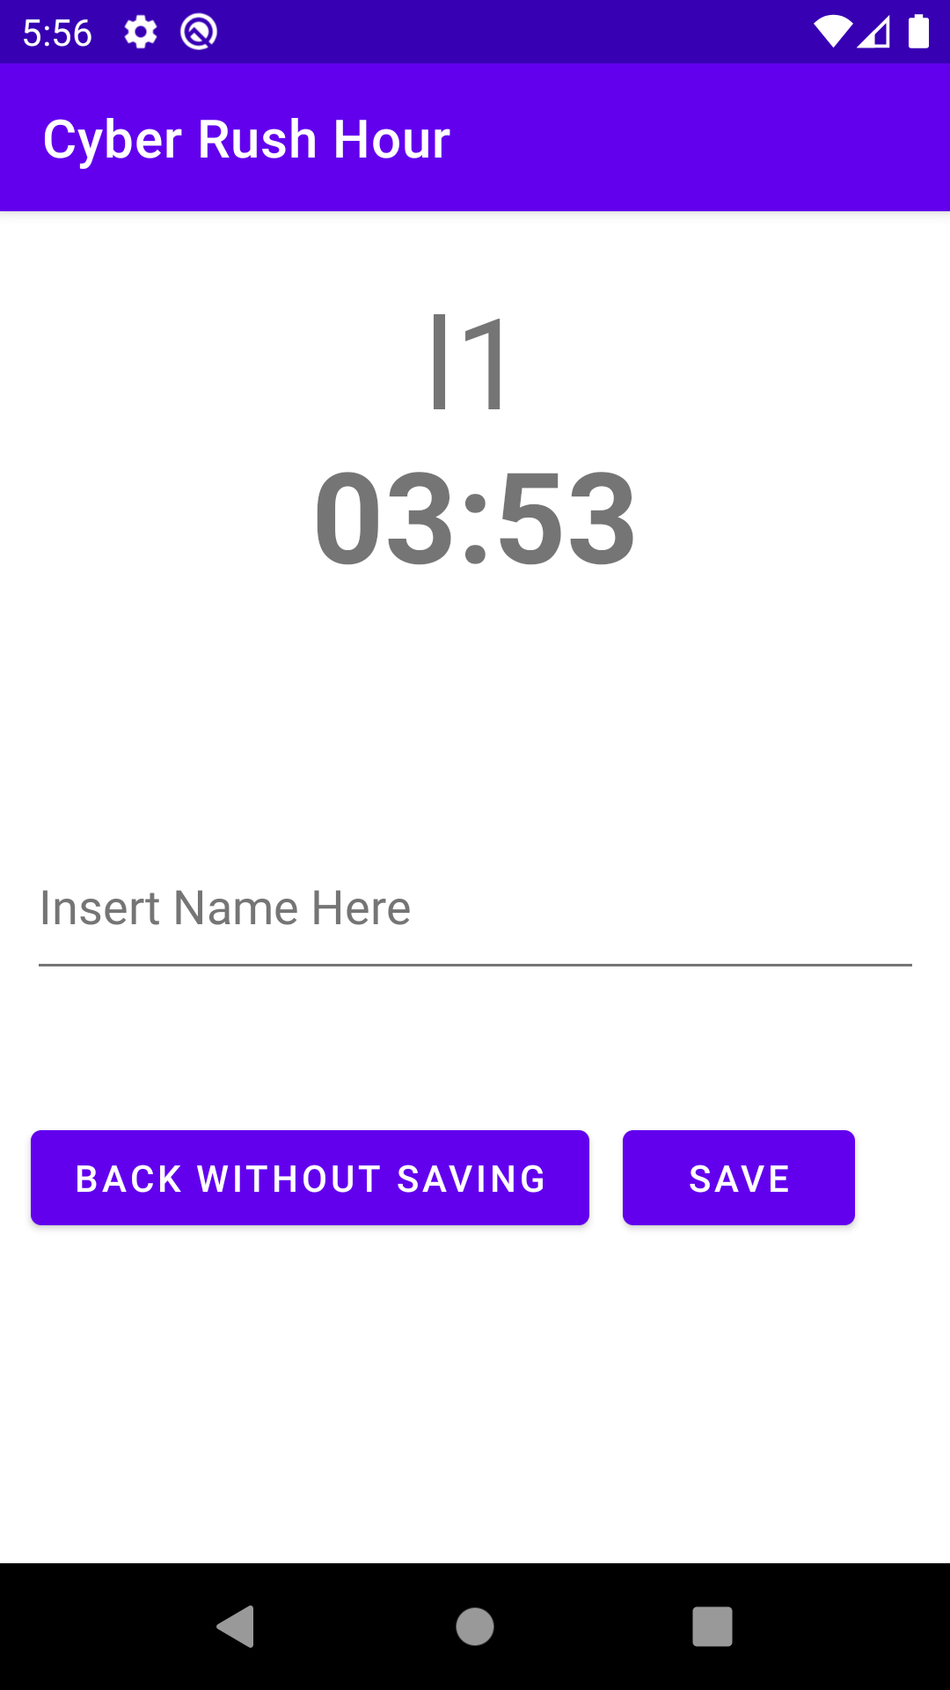
End of Game Activity:
After completion of the level, we move to this screen
At the top we see the name of the level and the time it took us.
Below we can either insert our name and save our score to the Database
Or simply quit without saving
A warning will be shown if you try saving without inserting a name.

Slide 20
Code:
onCreate it gets an instance of the firestore database should we need it, reads from the intent the name of the level and the amount of time it took and sets it on screen.
backToMenu() – simply takes us back to the main menu
saveAndBackToMenu() – gets the user name from the textview that the user was supposed to fill. If its empty, a toast warning will pop out and return. If it has a name, it creates a highScoreObject with the user name and the time that was sent over via the intent. After sending the high score to the database, it closes the activity, returning us to the main menu.

Slide 21
Thank you very much.
Any questions?

